Slide 1
<Project Logo>
Unified Experience Tracker
13/06/2023
PMO-TPL-013_v.1.0

Slide 2
01 UI Designs
02 Brandscopic API Details
03 Power App Limitations
04 UET Process Flow Diagram
05 Technology Stack
06 Cost Comparison
07 Questions

Slide 3
01
UI Designs

Slide 4
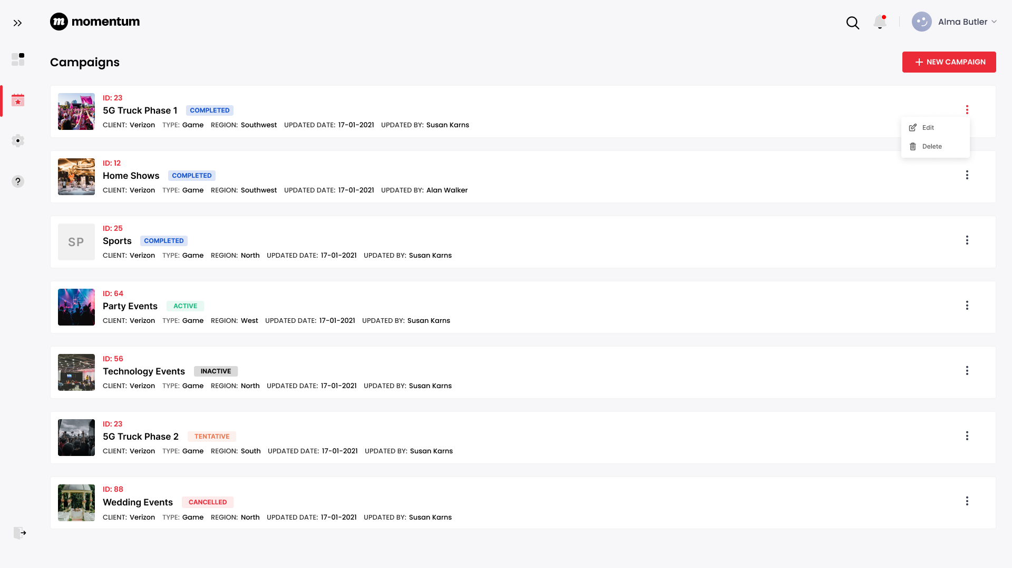
Campaigns

Slide 5
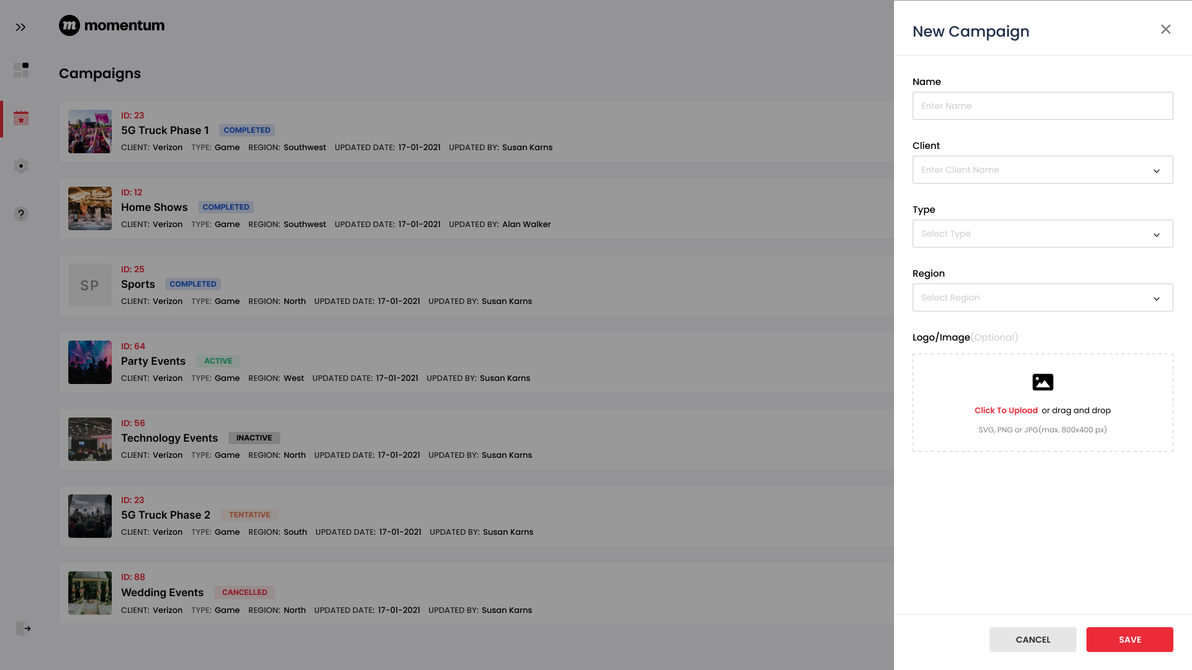
New Campaign

Slide 6
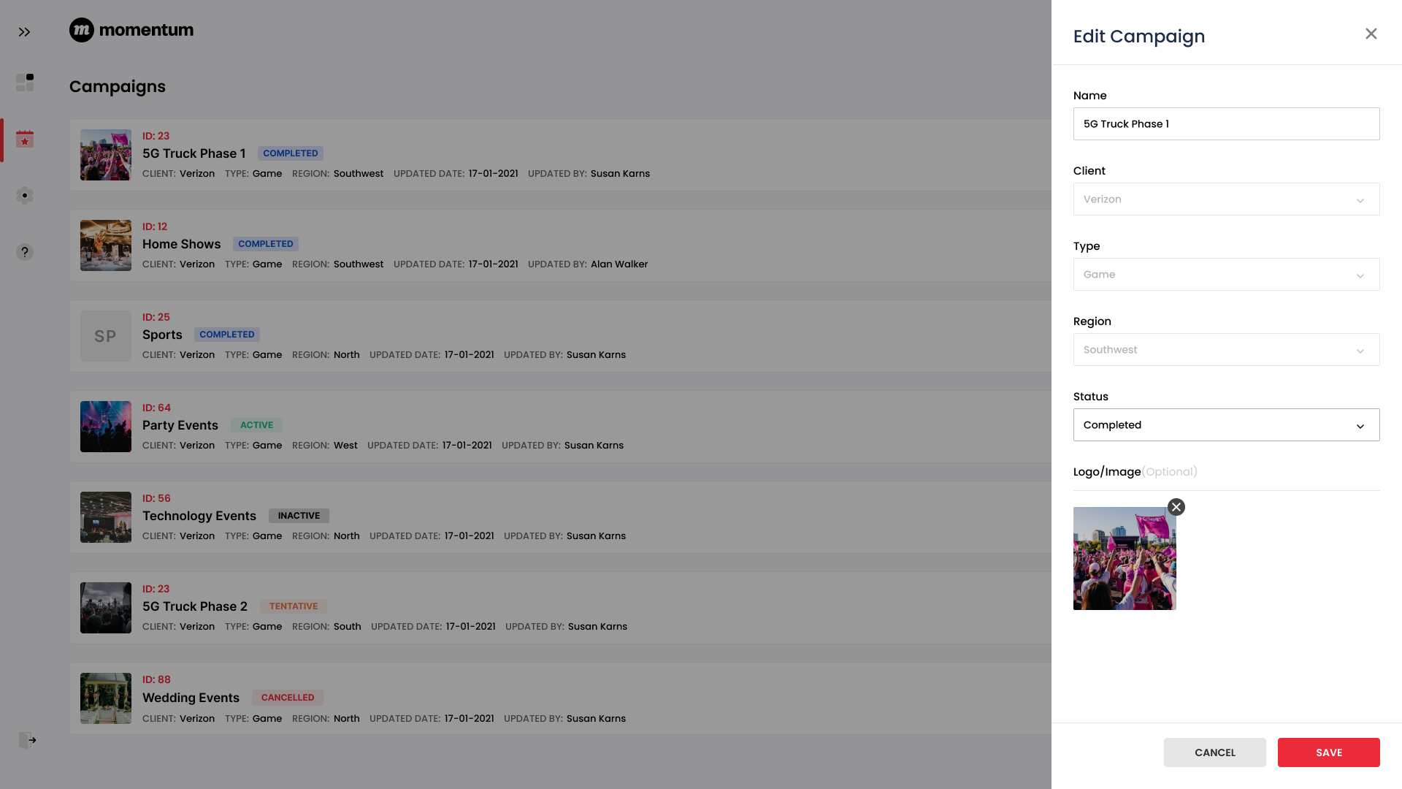
Edit Campaign

Slide 7
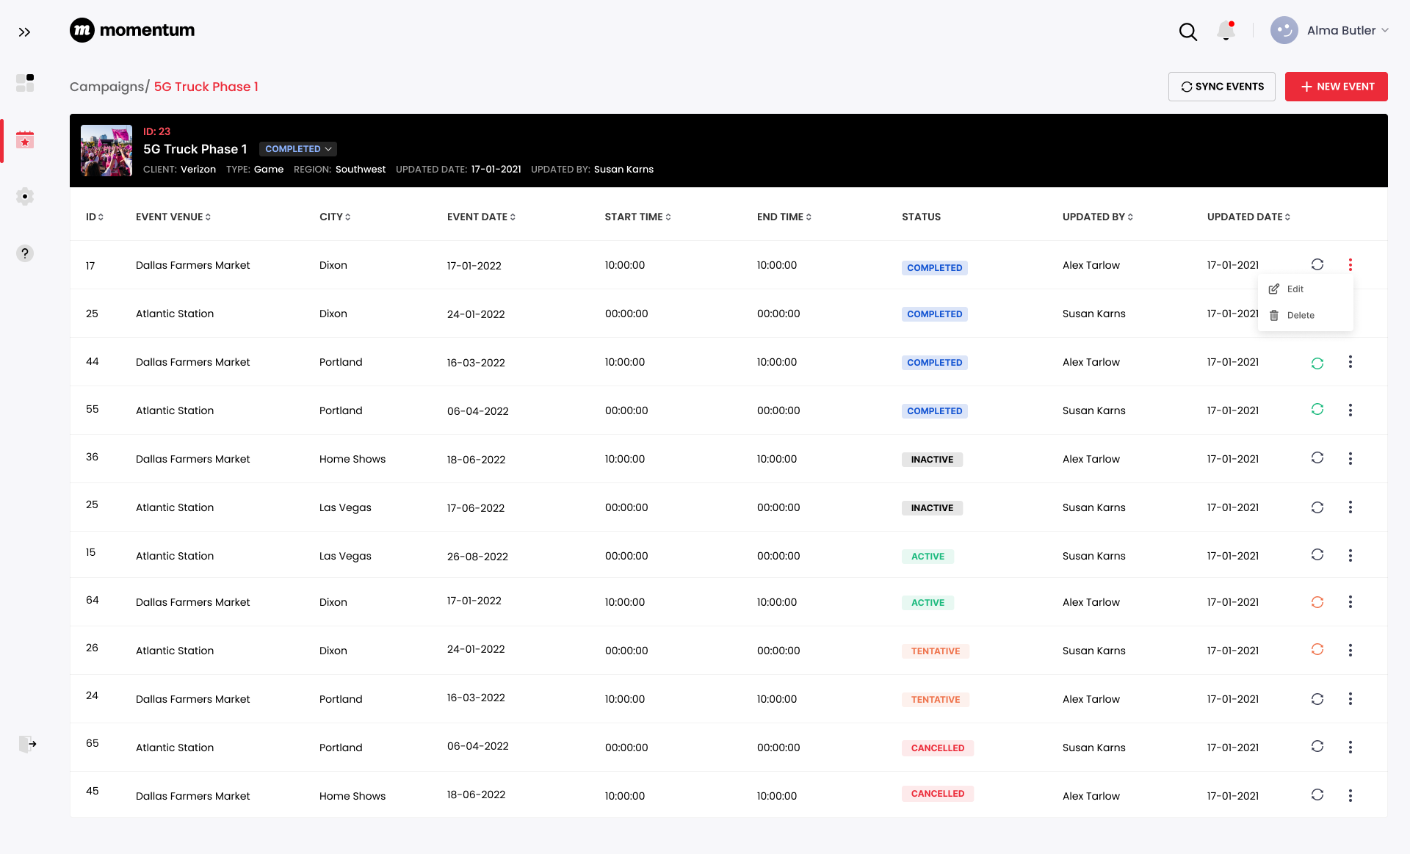
Events

Slide 8
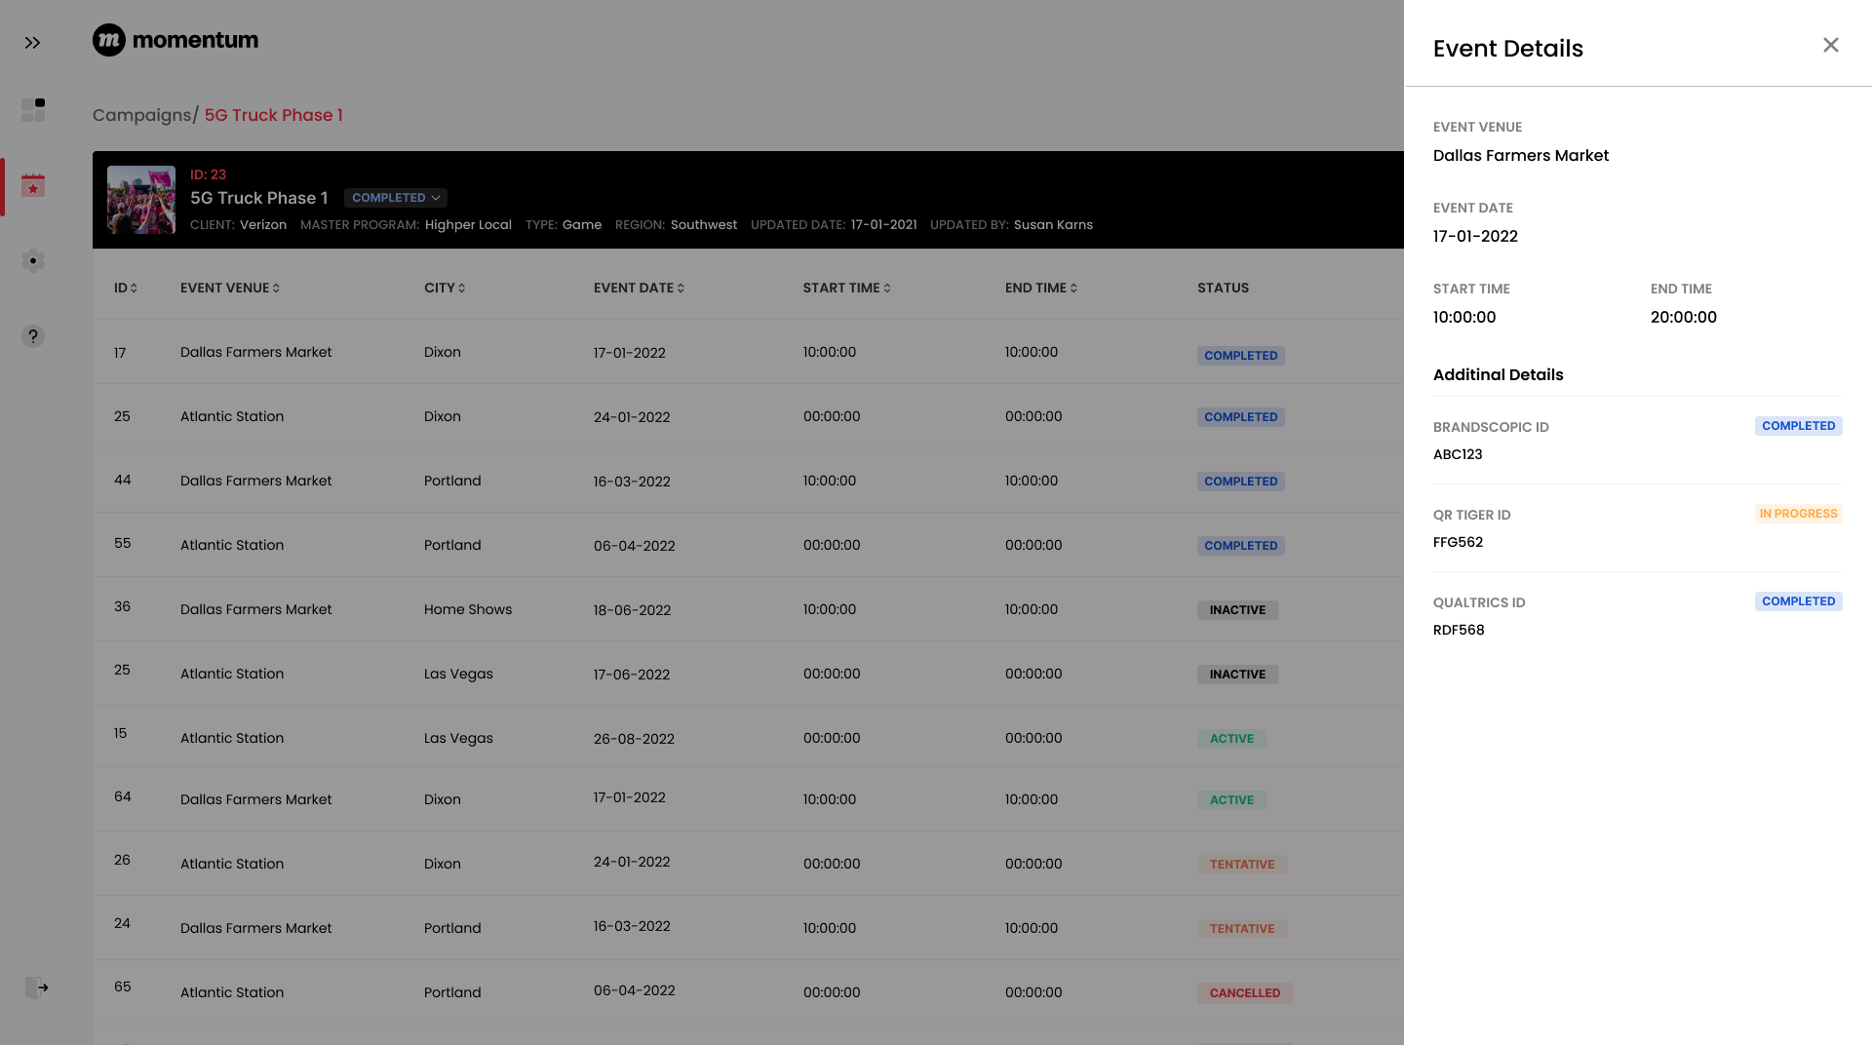
Event Detail

Slide 9
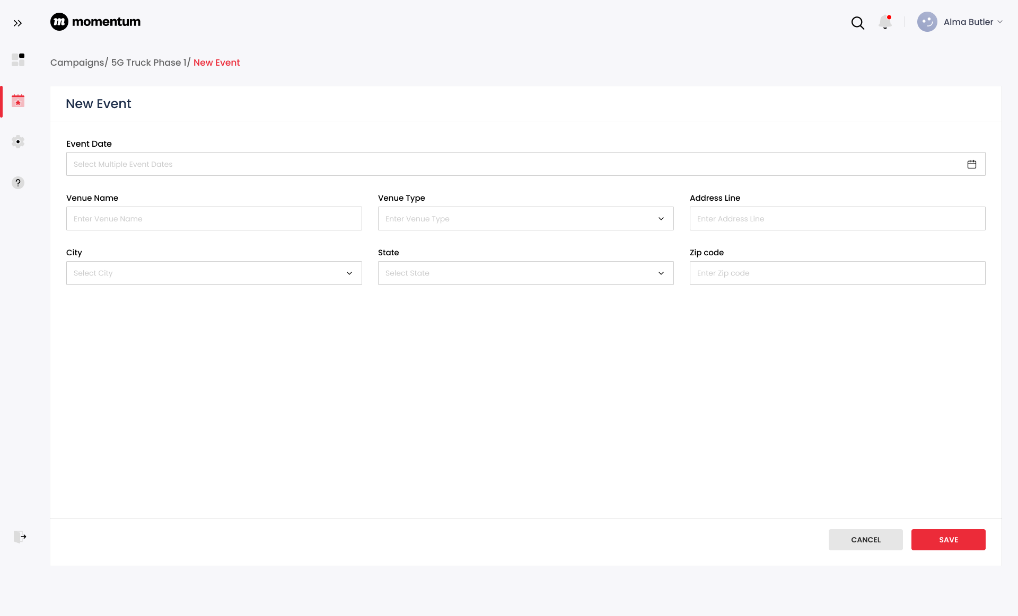
New Event

Slide 10
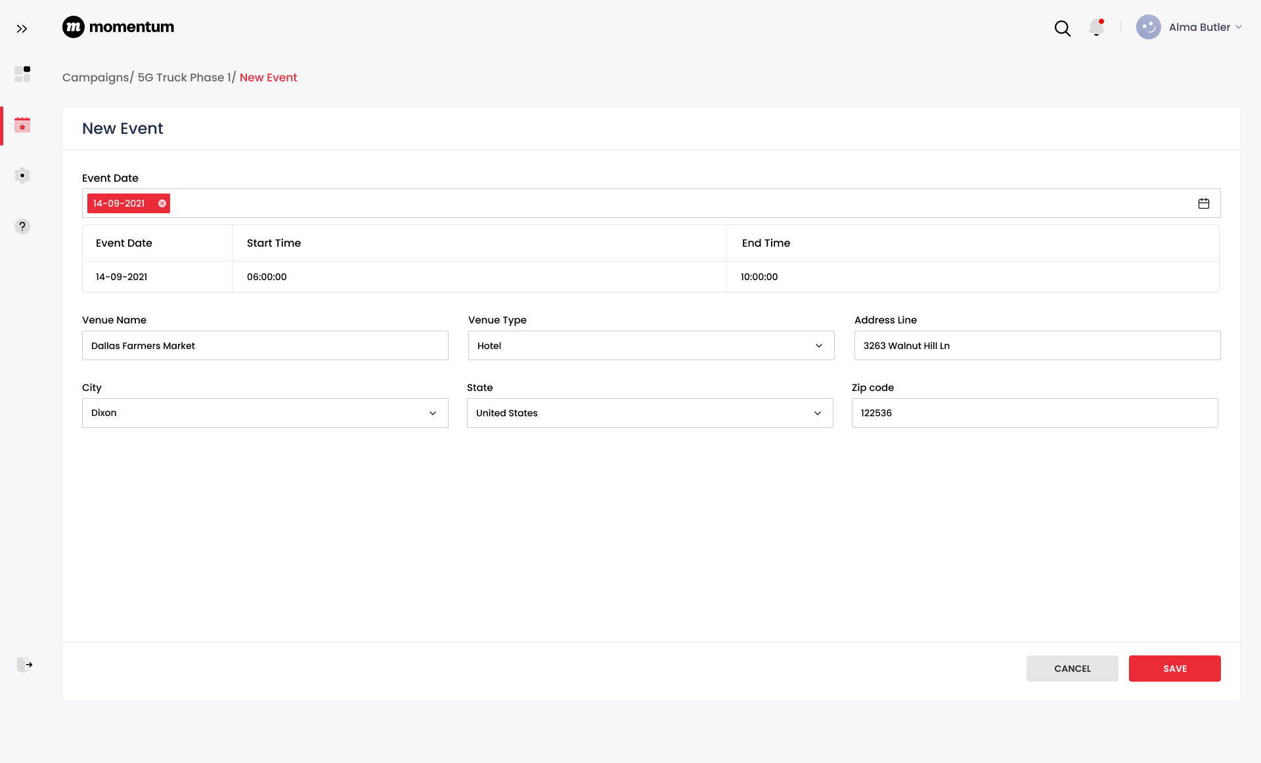
New Event

Slide 11
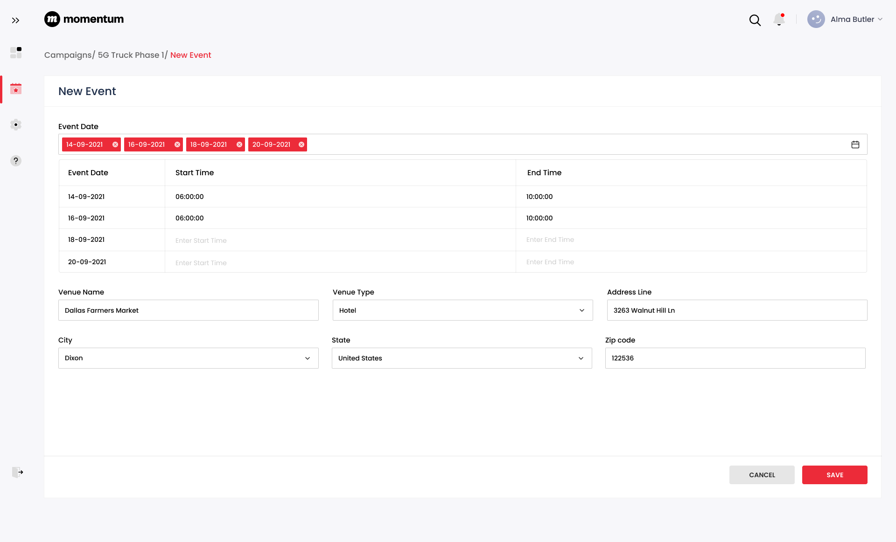
New Event

Slide 12
02
Brandscopic API Details

Slide 13
Brandscopic API Details
Create Event:
  URL: /api/v1/events
  Method: POST
  Payload: campaign_id, start_date, end_date, start_time, end_time, place_reference(Venue), active, description, results_attributes, visit _id
  campaign_id will be managed in the UET database and will be mapped with events created in Brandscopic (No API is available in Brandscopic API docs to create a campaign)
2. List Events associated with the Campaign:
  URL: /api/v1/campaigns/:id/events
  Method: GET
  Returns an array of associated events
Get Event Results(Analytical Data):
  URL: /api/v1/events/:id/results
  Method: GET

Slide 14
Brandscopic API Details
Events Result data:
  Modules/Categories:
    Demographics
      Fields: Gender, Age, Ethnicity/Race
    Consumer Reach
      Fields: Impressions, Interactions, Samples
    Custom

Slide 15
03
Power App Limitations

Slide 16
Power App Limitations
Licensing is constrained under the Microsoft 365 umbrella. Power Apps forms can only operate within the licensed business domain. However, users can share content with their colleagues and guest users who have Active Directory accounts and Power Apps licenses. Power Apps Portal also offers third-party and anonymous access. https://powerapps.microsoft.com/en-au/pricing/
Power Apps are good for building simple forms quickly, but forms with complex logic can cause problems due to their limited capabilities to manage the code base and track changes.
Version control support for Power Apps is in the Experimental Phase. https://learn.microsoft.com/en-us/power-apps/maker/canvas-apps/git-version-control \
If we use the Canvas application, only one developer can work at a time.
Can not integrate JavaScript in power app forms.
Poor reusability: Power Apps is geared towards those who are not professional programmers. You cannot create functions on Power Apps. Suppose you have a specific block of code that you need to run multiple times. In that case, you will need to copy and paste your code which increases the margin of error, decreases readability, and feels illegal to any programmer.
Debugging is very difficult as there is no traditional logging mechanism, but instead a Monitor that shows every command your app runs and whether it was a success or not.
Power BI tile control to integrate Power BI reports in Power Apps. When you share an app that contains Power BI content, you must share not only the app itself but also the dashboard where the tile comes from. Otherwise, the Power BI content won't appear even for users who open the app. Apps that contain Power BI content respect the permissions for that content.

Slide 17
Power App Limitations
Doesn’t support direct SQL queries. https://powerusers.microsoft.com/t5/Webinars-and-Video-Gallery/Type-and-Run-a-SQL-Query-inside-PowerApps/td-p/113062
If we use the Canvas application, only one developer can work at a time.
Power BI tile control to integrate Power BI reports in Power Apps:
  When you share an app that contains Power BI content, you must share not only the app itself but also the dashboard where the tile comes from. Otherwise, the Power BI content won't appear even for users who open the app. Apps that contain Power BI content respect the permissions for that content.
  https://learn.microsoft.com/en-us/power-apps/maker/canvas-apps/controls/control-power-bi-tile?source=recommendations#sharing-and-security

Slide 18
04
UET Process Flow Diagram

Slide 19
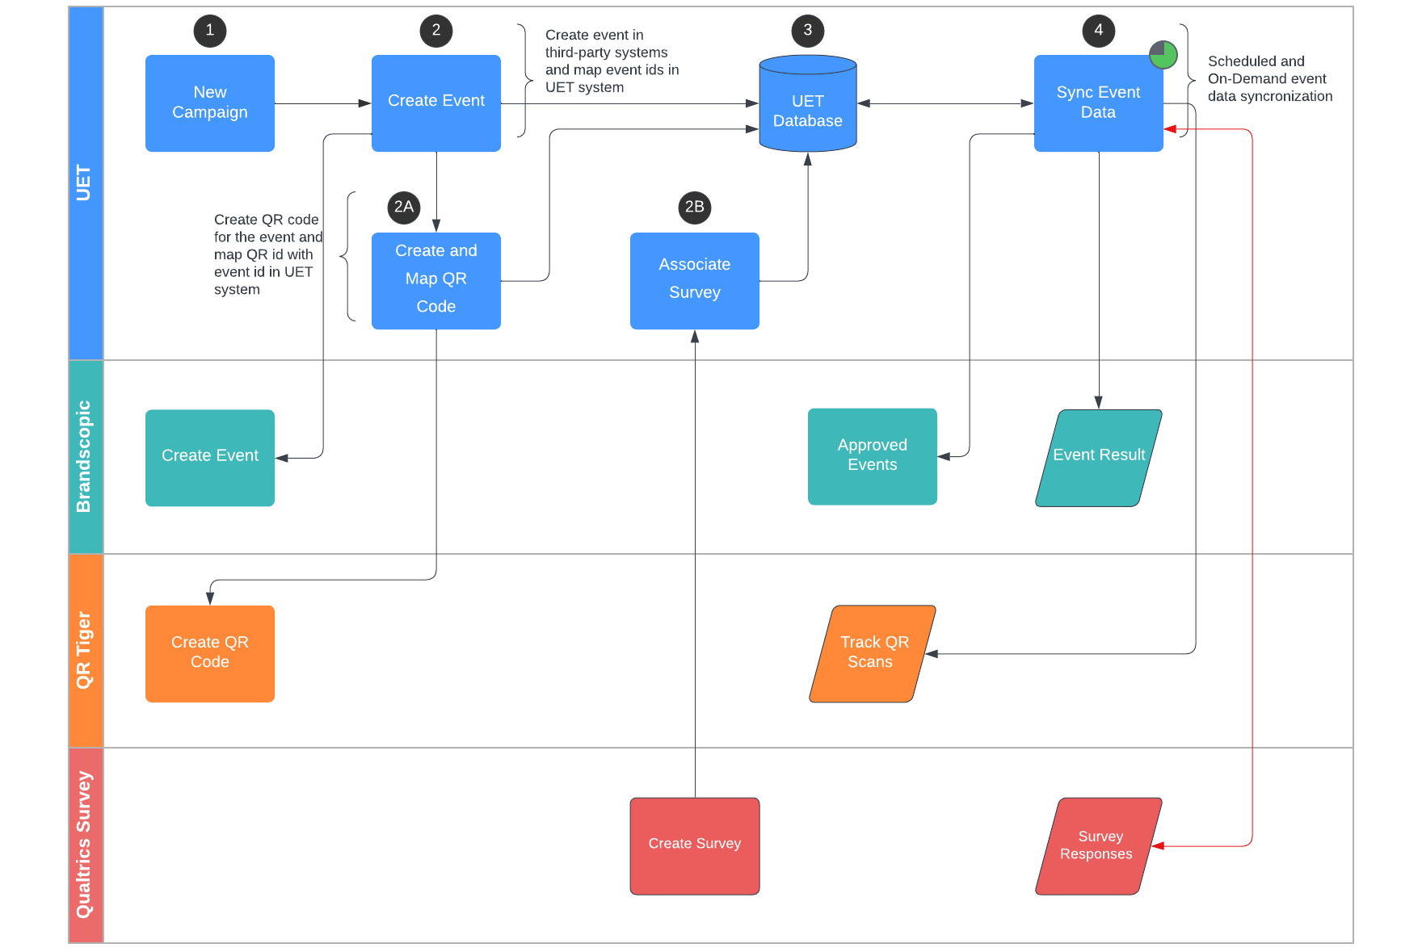
UET Process Flow Diagram

Slide 20
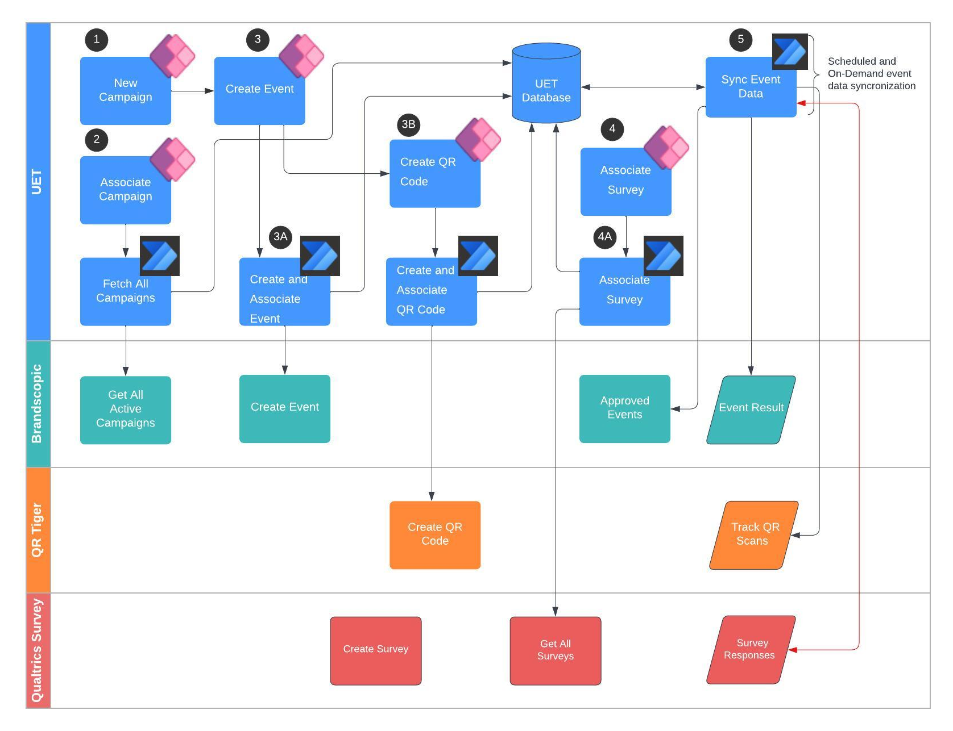
UET Process Flow Diagram

Slide 21
05
Technology Stack

Slide 22
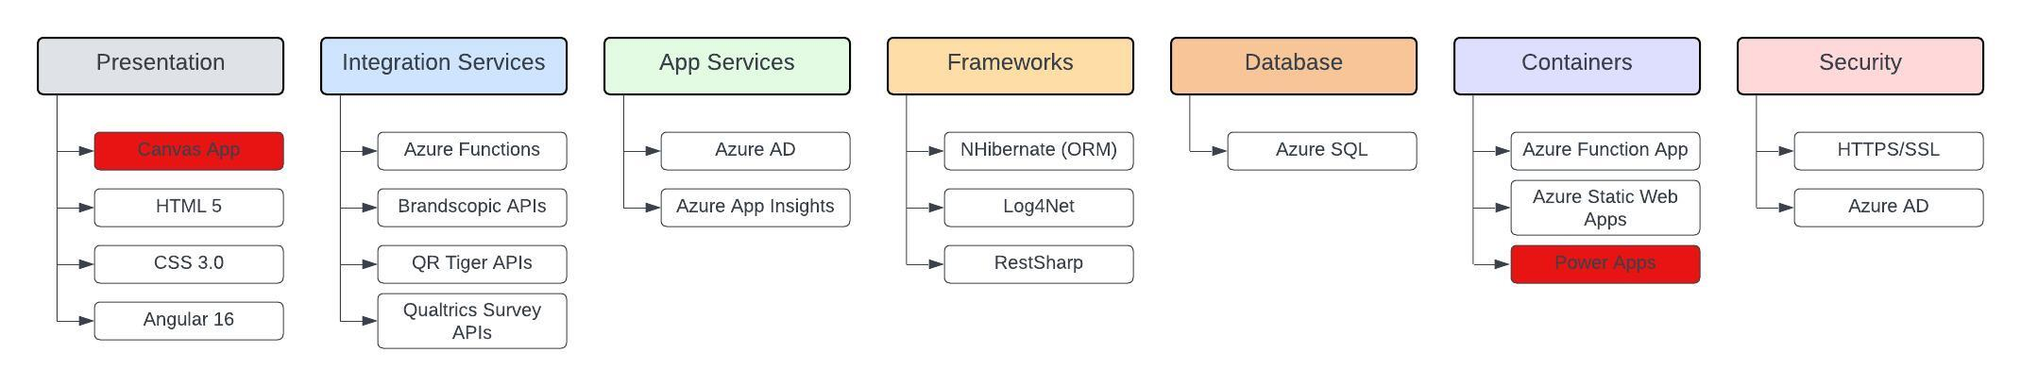
Technology Stack

Slide 23
06
Cost Comparison

Slide 24
Cost Comparison
Power Platform
Power Platform Pricing
Azure Services
The Azure SQL Database costing is not added in this comparison, as both approaches will use it.

Slide 25
Cost Comparison
Power Apps Pricing: https://powerapps.microsoft.com/en-us/pricing/
Power Automate Pricing: https://powerautomate.microsoft.com/en-us/pricing/
Compare Power Automate Plans: https://learn.microsoft.com/en-us/power-platform/admin/power-automate-licensing/types#compare-power-automate-plans
Premium Connectors: https://learn.microsoft.com/en-us/power-platform/admin/power-automate-licensing/types#premium-connectors

Slide 26
07
Questions

Slide 27
Questions
Can you please confirm that in Brandscopic currently, events are being created independently and it’s not associated with Campaign?
  Does Brandscopic have any API to create a Campaign?
  Can you please provide access to the lower environment of Brandscopic APIs for the 1Rivet team?
What is the process of manually collecting and entering data into Excel for the dev.lqa master? Can we standard the excel template, so that this portion can be automated as well.
Are there any common data fields across all the field management systems for collecting post-event metrics?
What fields are configured in Brandscopic to collect the post-event metrics? This information will help us understand which post-event data we would be able to collect from Brandscopic API integration.
Can you please clarify how integration with Qualtrics will work? Will the UET platform integrate directly with Qualtrics, or will Qualtrics be integrated with Brandscopic, and the UET platform will retrieve details from there?

